Slide 1

Smart Learning Platform
Group members: Feng Yuqing, Wang Yi, Li Sinuo, Zhang Fangxiao
2025.4.10

Slide 2
Introduction and Progress Update
CONTENTS
Architecture
Challenges
Current Implementation
Upcoming Milestone

Slide 3
01
Introduction and Progress Update

Slide 4

Review
This project aims to enhance students' learning experience by integrating AI technology and intelligent features. We will create an online learning platform that combines a virtual learning assistant, intelligent clock, and data analysis to meet demands for personalization, real-time feedback, and efficient management. The platform will provide real-time question answering, personalized feedback, immersive study tracking, and relaxation reminders, making the learning process more engaging and effective.
Notes:
图片解释：
A typical CNN is not just the 3 layer structure mentioned above, but a multi-layer structure, such as the structure of LeNet-5 as shown below:
Convolutional layer-Pooling layer-Convolutional layer-Pooling layer-Convolutional layer-Fully connected layer

Slide 5
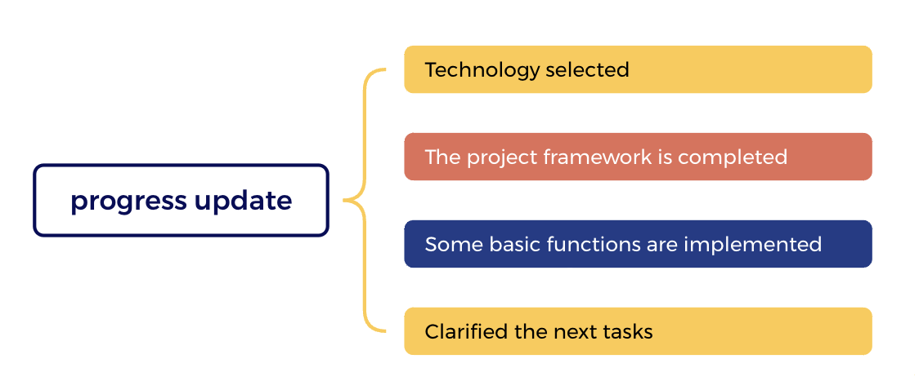
Progress Update
Milestone: technology selection, core function planning, architecture design, and preliminary development preparation.
Deliverables: First progress report, including technology selection, core function planning, and screenshots of preliminary development.
Notes:
图片解释：
A typical CNN is not just the 3 layer structure mentioned above, but a multi-layer structure, such as the structure of LeNet-5 as shown below:
Convolutional layer-Pooling layer-Convolutional layer-Pooling layer-Convolutional layer-Fully connected layer

Slide 6
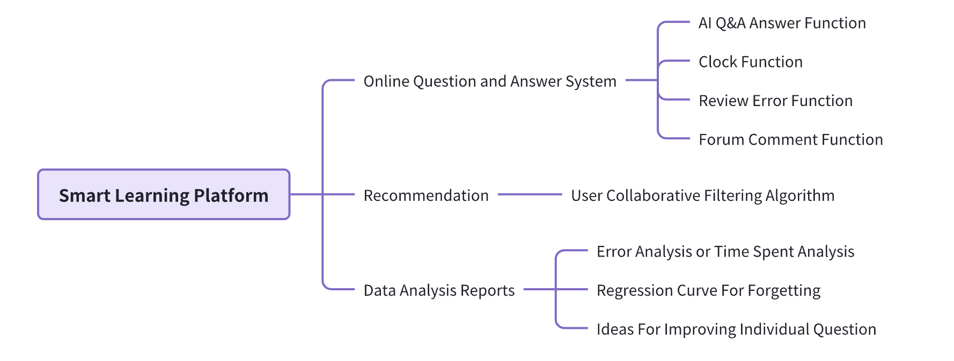
Core function planning
Notes:
图片解释：
A typical CNN is not just the 3 layer structure mentioned above, but a multi-layer structure, such as the structure of LeNet-5 as shown below:
Convolutional layer-Pooling layer-Convolutional layer-Pooling layer-Convolutional layer-Fully connected layer

Slide 7
02
Architecture

Slide 8
03
Challenges

Slide 9
Challenges
1. Database Design & Performance Optimization
Many-to-Many Relationship Modeling: Implemented intermediate tables to manage the association between problems and tags.
Redis Integration: Used for caching and fast indexing of user submission data to enhance query performance.
Balancing Normalization and Query Efficiency: Applied proper indexing and normalization strategies to ensure scalable and efficient database operations.
Notes:
图片解释：
A typical CNN is not just the 3 layer structure mentioned above, but a multi-layer structure, such as the structure of LeNet-5 as shown below:
Convolutional layer-Pooling layer-Convolutional layer-Pooling layer-Convolutional layer-Fully connected layer

Slide 10
Challenges
2. User Module Security
Password Encryption: Utilized algorithms like MD5 to securely store user passwords. To prevent hash collisions, we will upgrade to BCrypt for password encryption and verification.
Authentication & Authorization: Implemented JWT mechanisms for session control and secure API access.
Permission Validation: Ensured users can only access and modify their own data to prevent unauthorized operations.
Notes:
图片解释：
A typical CNN is not just the 3 layer structure mentioned above, but a multi-layer structure, such as the structure of LeNet-5 as shown below:
Convolutional layer-Pooling layer-Convolutional layer-Pooling layer-Convolutional layer-Fully connected layer

Slide 11
Challenges
3. Dependency Conflicts & POM Configuration
Dependency Tree Analysis: Used mvn dependency:tree to identify the root cause of conflicts.
Exclusion of Conflicting Dependencies: Resolved version issues using <exclusions> in pom.xml.
Unified Version Management: Maintained consistent dependency versions to improve project stability and maintainability.
Notes:
图片解释：
A typical CNN is not just the 3 layer structure mentioned above, but a multi-layer structure, such as the structure of LeNet-5 as shown below:
Convolutional layer-Pooling layer-Convolutional layer-Pooling layer-Convolutional layer-Fully connected layer

Slide 12
04
Current Implementation

Slide 13
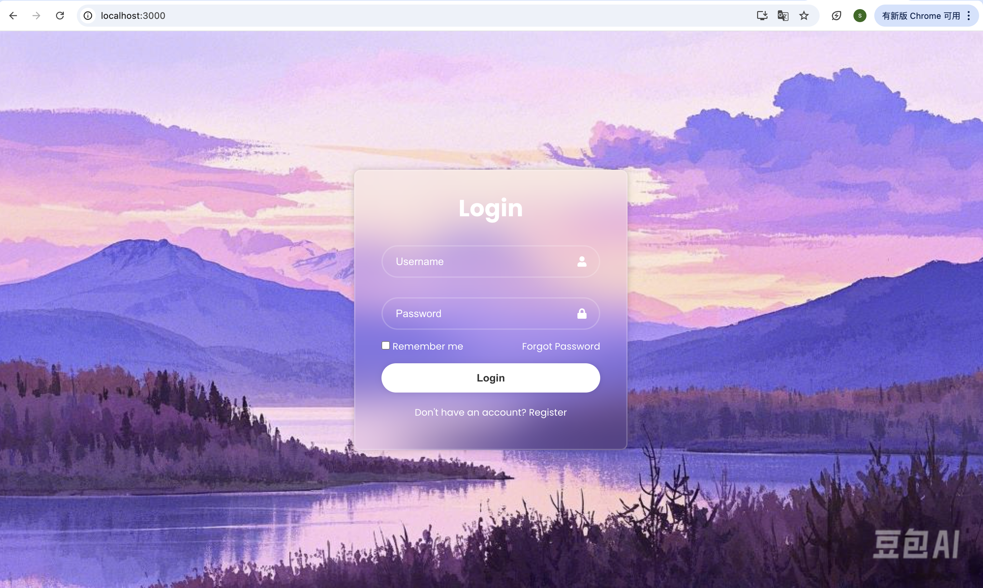

Current Implementation
Registration & Login Page
Notes:
图片解释：
A typical CNN is not just the 3 layer structure mentioned above, but a multi-layer structure, such as the structure of LeNet-5 as shown below:
Convolutional layer-Pooling layer-Convolutional layer-Pooling layer-Convolutional layer-Fully connected layer

Slide 14
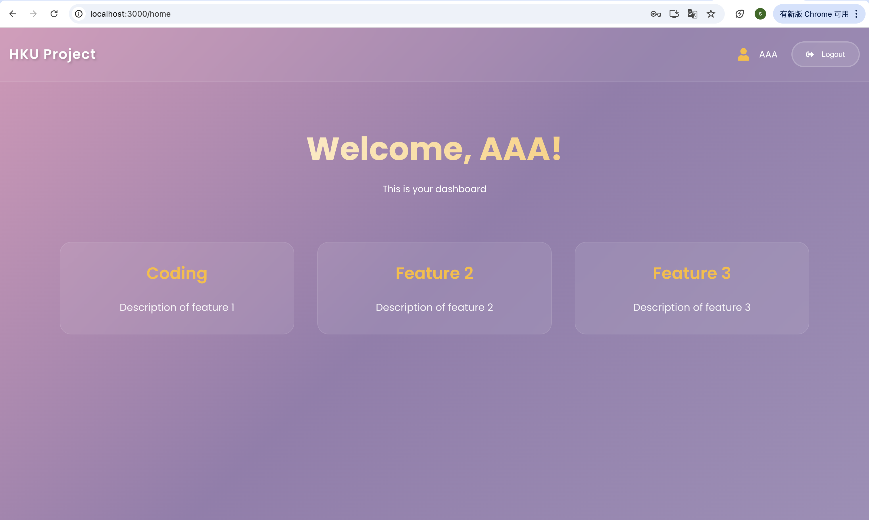
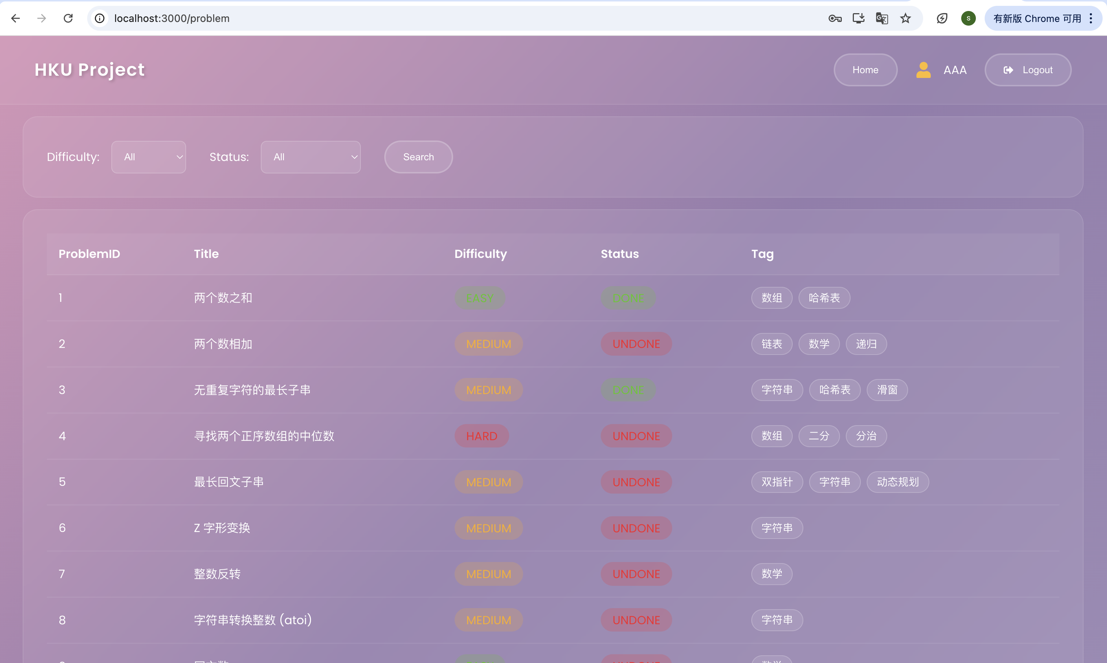
Current Implementation
Home & Problem Page
Notes:
图片解释：
A typical CNN is not just the 3 layer structure mentioned above, but a multi-layer structure, such as the structure of LeNet-5 as shown below:
Convolutional layer-Pooling layer-Convolutional layer-Pooling layer-Convolutional layer-Fully connected layer

Slide 15
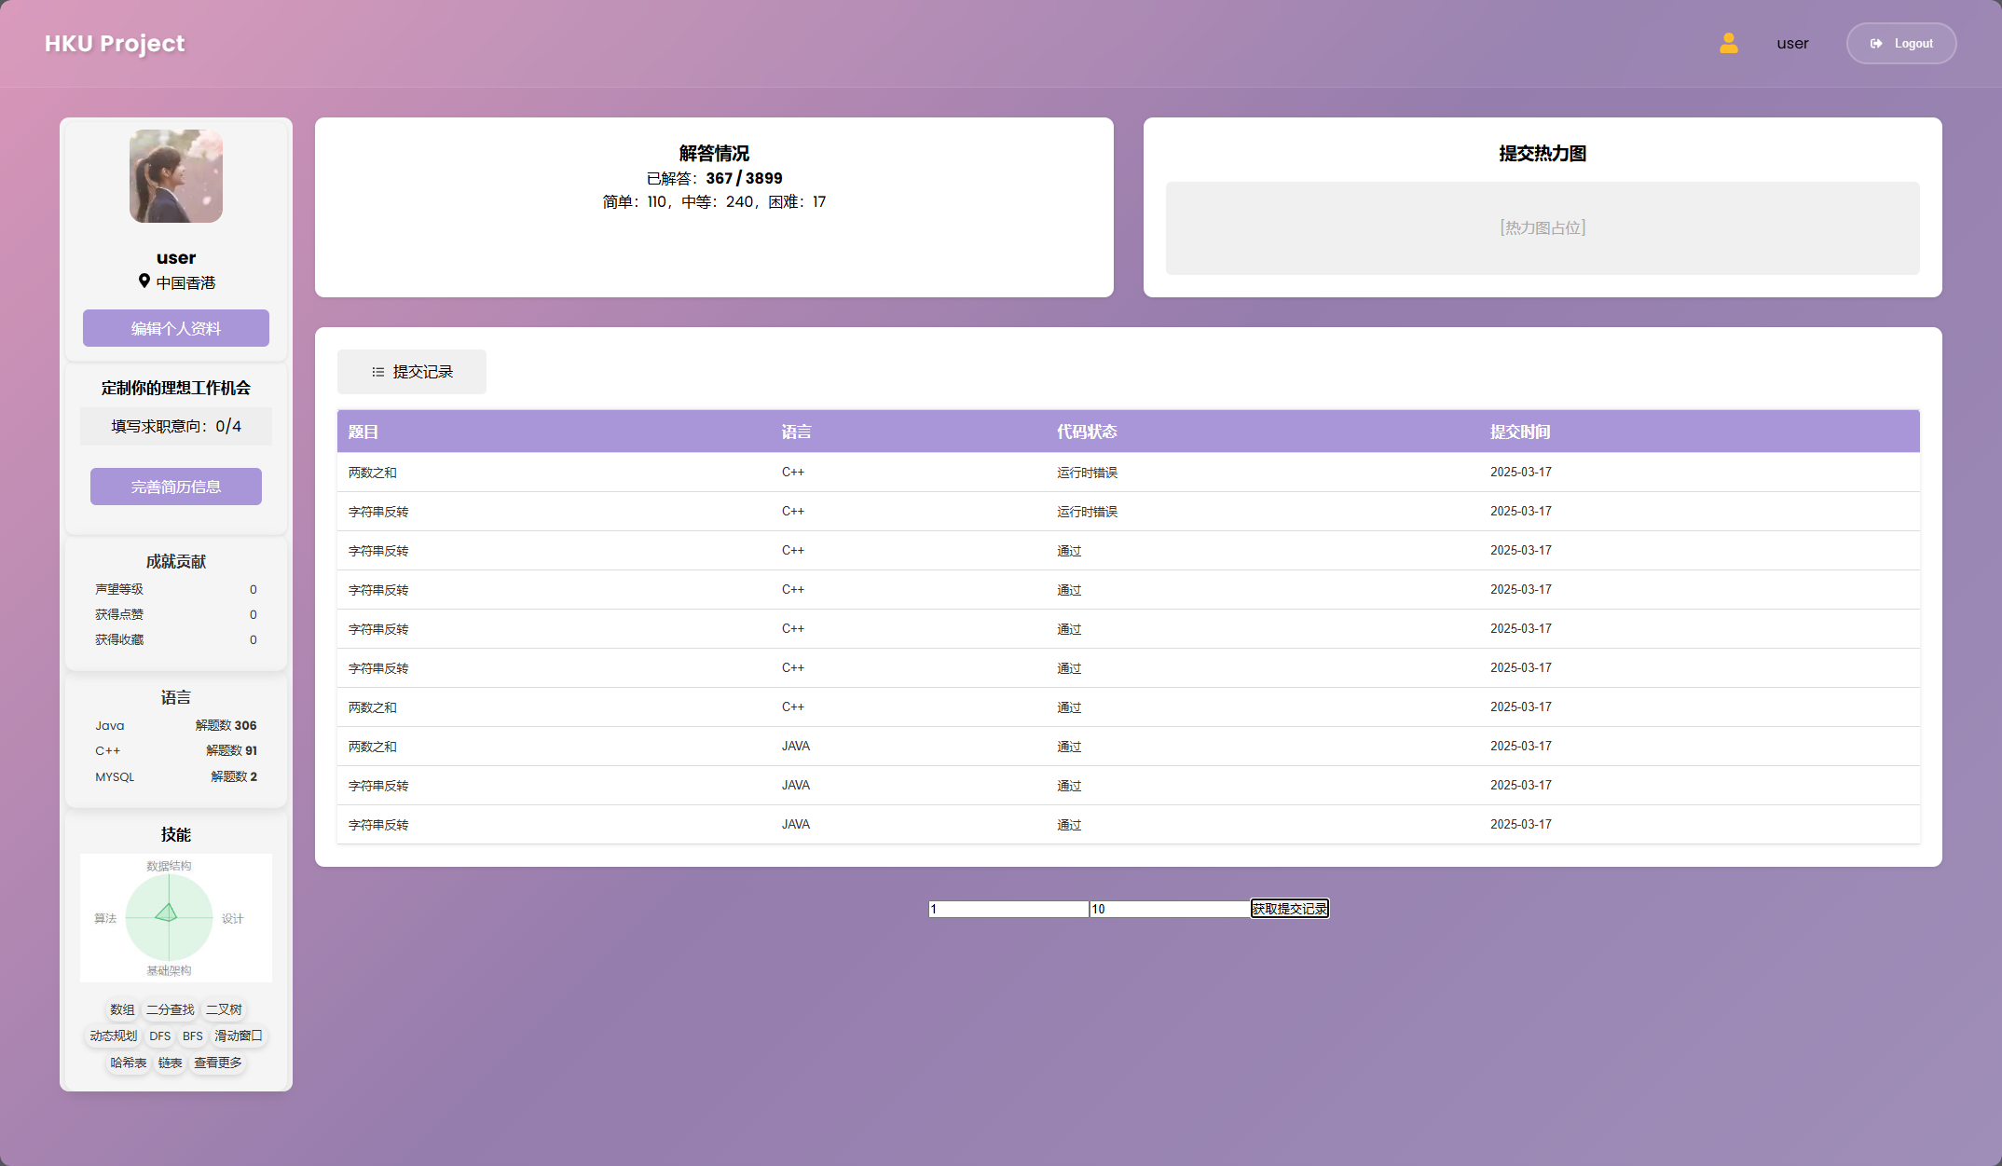
Current Implementation
User Page
Notes:
图片解释：
A typical CNN is not just the 3 layer structure mentioned above, but a multi-layer structure, such as the structure of LeNet-5 as shown below:
Convolutional layer-Pooling layer-Convolutional layer-Pooling layer-Convolutional layer-Fully connected layer

Slide 16
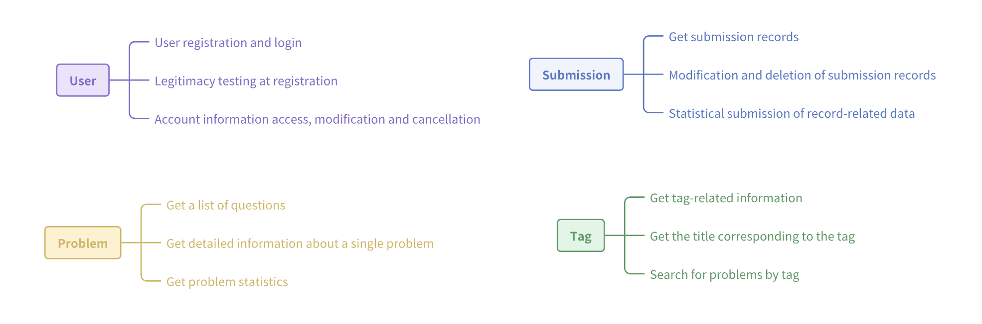
Current Implementation
Other Implementation Functions
Notes:
图片解释：
A typical CNN is not just the 3 layer structure mentioned above, but a multi-layer structure, such as the structure of LeNet-5 as shown below:
Convolutional layer-Pooling layer-Convolutional layer-Pooling layer-Convolutional layer-Fully connected layer

Slide 17
05
Upcoming Milestone

Slide 18
Upcoming Milestone
User Analytics and AI Model Selection: Define the user's main requirements and choose the most suitable AI Agent model.
Main Functions Implementation: Complete the development of basic logic and key functions of AI Q&A.
Designing and optimising interactive interfaces:
Designing a user-friendly interaction flow to improve the ease of use of AI Q&A.

